Slide 1




SNR-based Adaptive Semantic Communication in Vehicular Networks
2025 International Conference on Trustworthy Big Data and Artificial Intelligence
Reporter: Zhentong Feng
Notes:
“Good afternoon, everyone. My name is Zhentong Feng, from Baotou Teachers’ College in China. Today, I’m honored to present our work titled SNR-based Adaptive Semantic Communication in Vehicular Networks, at the 2025 International Conference on Trustworthy Big Data and Artificial Intelligence.”

Slide 2
CONTENTS
Motivation
1
System Architecture
Experimental Setup
2
3
Key Results
Conclusion
4
5
Acknowledgment
6

Slide 3
01
Motivation

Slide 4
Motivation
Vehicular Networks Challenges
Rapid mobility → frequent SNR fluctuations
Traditional systems → fixed encoding, poor under noise
Focus on meaning, not bit-perfect reconstruction
Enables low-bandwidth, robust transmission
Semantic Communication Advantage
Notes:
“Vehicular networks face unique challenges. Because of rapid mobility, the wireless channel experiences frequent signal-to-noise ratio, or SNR, fluctuations. Traditional communication systems aim for exact bit reconstruction, but they often fail under such dynamic conditions. Semantic communication offers an alternative — instead of transmitting every bit, it focuses on preserving meaning, which makes transmission more efficient and robust under noise.”

Slide 5
Limitations of Existing Methods
1
Fixed SNR assumptions
2
Lack of real-time adaptation
Limitations of Existing Methods
添加
标题
2
High computational overhead
3
Few tailored solutions for vehicular environments
Notes:
“However, many existing semantic communication methods assume fixed SNR environments. They lack the flexibility to adapt in real time, and often introduce high computational overhead. Moreover, very few works are tailored to vehicular networks, which demand real-time, adaptive solutions. This motivated us to design a more efficient and adaptive semantic communication system.”

Slide 6
02
System Architecture

Slide 7
Our Contribution
01
04
Propose: SNR-based adaptive semantic communication system
Achieves high semantic fidelity under low SNR
02
Dynamically selects neural encoding or direct transmission based on SNR
05
Saves computation under high SNR
03
Tested on MNIST & CIFAR-10 datasets
Notes:
“Our contributions can be summarized as follows: First, we propose an SNR-based adaptive semantic communication framework. Second, the system dynamically selects between neural encoding and direct transmission depending on SNR. Third, we evaluate this framework on both simple data — MNIST — and complex data — CIFAR-10. Finally, we demonstrate that the proposed approach preserves semantic fidelity at low SNR, while saving computation at high SNR.”

Slide 8
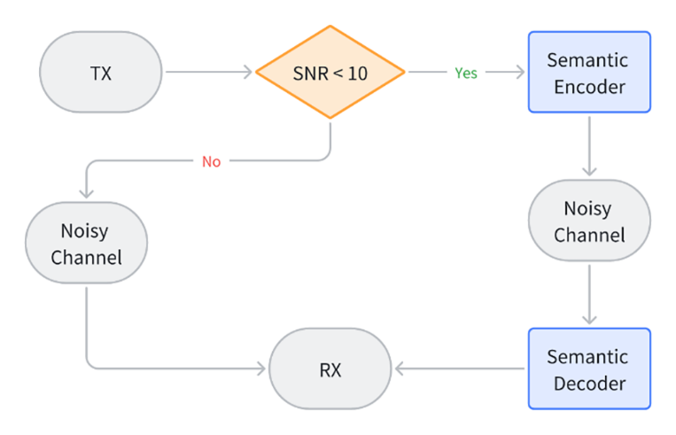
System Architecture
Diagram
Low SNR (<10 dB) → Compression + Denoising (RED-CNN / MLP)
High SNR (≥10 dB) → Direct transmit
Two regimes
Notes:
“This is our system architecture. When the SNR is low, below 10 decibels, the system uses a deep neural encoder-decoder pipeline to perform compression and denoising. This ensures that even though pixel-level detail is lost, the semantic meaning — such as the object class — is preserved. When the SNR is high, above 10 decibels, the system directly transmits the image without neural processing, saving computational resources. This adaptive switching allows the system to remain robust across a wide range of channel conditions.”

Slide 9
03
Experimental Setup

Slide 10
Datasets
01
03
MNIST: 28×28 grayscale digits
Preprocessing: normalization, resizing if needed
02
04
Classifiers:
MNIST: 4-layer MLP
CIFAR-10: Fine-tuned GoogLeNet
CIFAR-10: 32×32 RGB images, 10 classes
Notes:
“To evaluate our system, we used two datasets. MNIST, which consists of 28 by 28 grayscale digits, and is simple but effective for testing. And CIFAR-10, which consists of 32 by 32 color images from ten categories, and is much more challenging. For classification, we used a 4-layer MLP for MNIST, and GoogLeNet for CIFAR-10.”

Slide 11
Experimental Setup
1
SNR range: 0–20 dB (10 values)
2
Compression rates: 0.1 – 1.0
添加
标题
Experimental Setup
2
Metrics: Accuracy (semantic) and PSNR (visual quality)
3
Noise model: Gaussian in latent space
Notes:
“Our experiments simulated wireless channels with SNR values ranging from 0 to 20 decibels. We tested compression rates between 0.1 and 1.0, where 0.1 means only 10 percent of the original data is kept. We evaluated performance using two metrics: classification accuracy, which captures semantic fidelity, and peak signal-to-noise ratio, or PSNR, which measures perceptual quality. Gaussian noise was introduced in the latent space to simulate channel degradation.”

Slide 12
04
Key Results

Slide 13
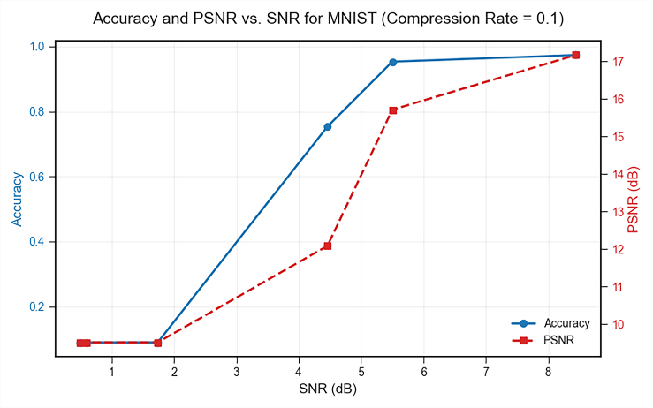
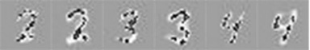
Key Results (MNIST)
01
At SNR = 4.46 dB, CR=0.1 → 94% accuracy
02
High compression still preserves meaning
Accuracy and PSNR
03
Accuracy improves with SNR
Reconstructed images
Notes:
“Here are the results for MNIST. Even under very noisy conditions, at an SNR of 4.46 decibels, and a high compression rate of 0.1, our system achieved 94 percent classification accuracy. This shows that semantic information can be preserved, even when most of the raw pixel information is lost. As SNR increases, the accuracy improves further, validating the effectiveness of our adaptive approach.”

Slide 14
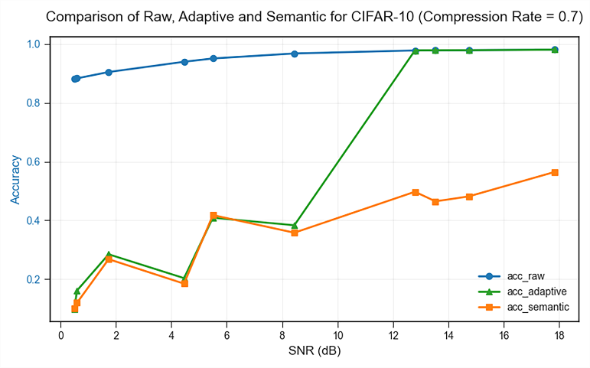
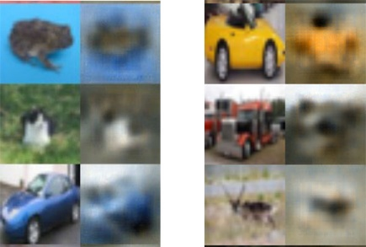
Key Results (CIFAR-10)
01
At CR=0.7, saves 30% bandwidth
02
Semantic meaning preserved under noise
Accuracy and PSNR
03
Adaptive strategy outperforms fixed methods at high SNR
Reconstructed images
Notes:
“For the more complex CIFAR-10 dataset, our system still performed well. At a compression rate of 0.7, we reduced bandwidth usage by 30 percent, while still preserving semantic meaning under noise. Compared to fixed strategies, our adaptive method consistently achieved higher classification accuracy, especially under high-SNR conditions. This shows the generalizability of our approach to real-world, high-complexity data.”

Slide 15
Insights
High SNR → Direct transmission saves computation
Well-suited for dynamic vehicular channels
01
02
03
04
Low SNR → Neural encoding boosts accuracy & PSNR
High compression (0.1 MNIST, 0.7 CIFAR-10) still useful
Notes:
“From the experiments, we draw four key insights: First, in low-SNR environments, neural encoding is crucial to maintain semantic accuracy. Second, in high-SNR environments, direct transmission is more efficient, with little performance loss. Third, even high compression rates preserve meaning, demonstrating the efficiency of semantic communication. Finally, this makes our system particularly well-suited for dynamic vehicular channels.”

Slide 16
05
Conclusion

Slide 17
Conclusion
SNR-based adaptation improves robustness & efficiency
1
2
Works in bandwidth-limited, noisy environments
添加
标题
Experimental Setup
2
Applicable to V2V / V2I real-time communication
3
Future Work: Video, multimodal data, RL-based adaptation
Notes:
“In conclusion, our proposed system intelligently adapts between neural encoding and direct transmission based on SNR. This enables a balance between robustness, semantic fidelity, and computational efficiency. The framework is especially useful for bandwidth-limited and noisy vehicular communication environments. Looking forward, we plan to extend this approach to video, multimodal data, and reinforcement learning-based adaptation policies.”

Slide 18

Acknowledgment
Postgraduate tutor:
Axida Shan
Funding sources:
Inner Mongolia Autonomous Region Natural Science Foundation,
Scientific Research Start-up Fund of Baotou Teachers’ College,
China University-Industry-Research Collaborative Innovation Fund
Notes:
“Firstly, I extend my sincere thanks to Axida Shan for their mentorship and for helping me navigate the challenges of this research project.
Secondly, I would like to acknowledge the support of the Inner Mongolia Autonomous Region Natural Science Foundation, and other 2 funds. Thank you for your attention, and I wish you have a good day.”

